Slide 1
Ayurvedic/Unani/Siddha
Unit Converter
By Team Exalt

Slide 2
PROBLEM STATEMENT:
Develop a toolset to conveniently convert Ayurvedic units to equivalent modern units.
~Ministry of Ayush

Slide 3
The need for Unit Conversion
Most of people are not known with the Ancient System of weights and measures
It can be used in mass scale production while still using standardized units
Makes and selling Ayurvedic medicine in pharmacies is easier
Ancient texts and ayurvedic manuals can be converted to modern units easily

Slide 4
Our Answer

Slide 5

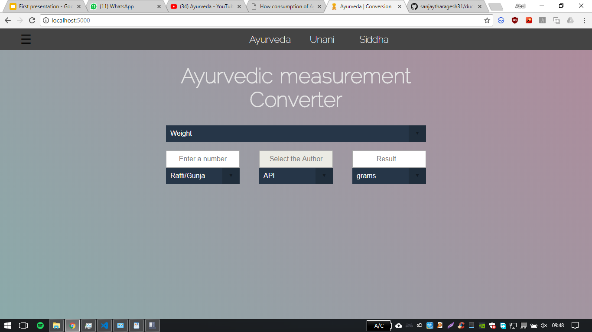


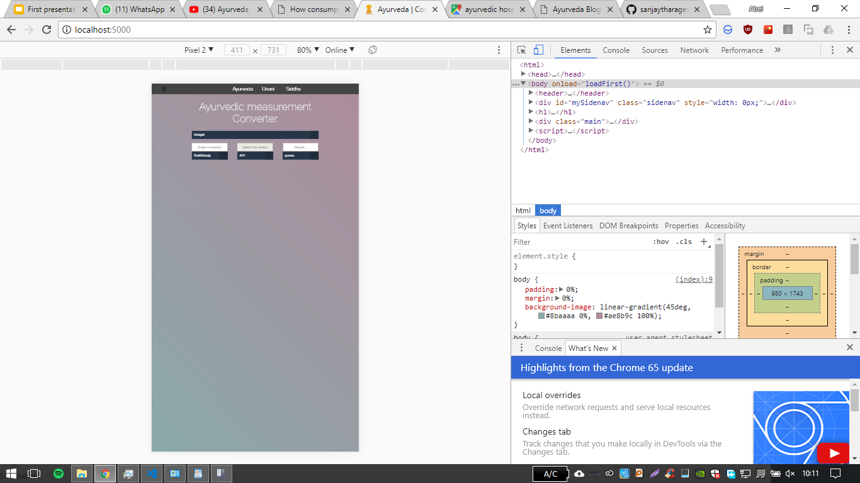
The Ayurvedic Unit Converter
The applet is available on
Web
Android
Telegram

Slide 6

The Web app
Can be accessed by everyone
Universal application
Not limited by Hardware
User Friendly
Simple, Efficient and Minimalistic Design
Multi-lingual

Slide 7
Features of the Webpage
Extremely lightweight, responsive design
Uses Deferred JavaScript to improve load speeds up to 230%
Uses Inline css to improve load speeds up to 80%
Flask framework i s used for the backend.
Can Handle upto 180,000 connections simultaneously

Slide 8

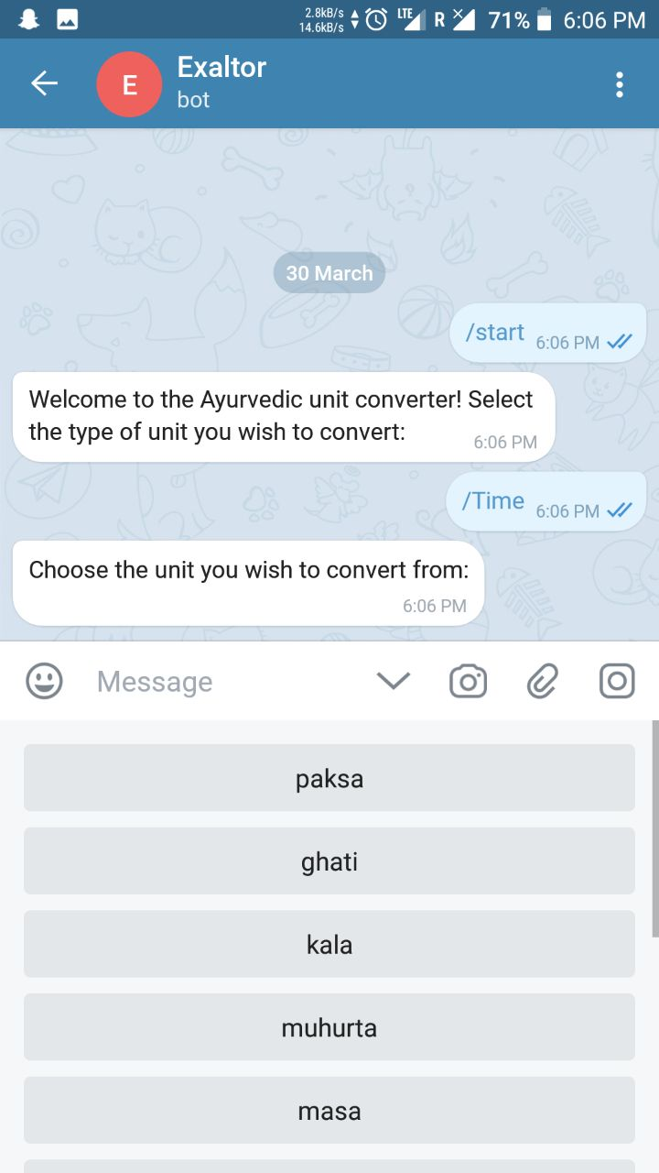
ChatBot
Human-friendly method of conversion
Ease of use
It’s Nearly platform independent

Slide 9


Slide 10
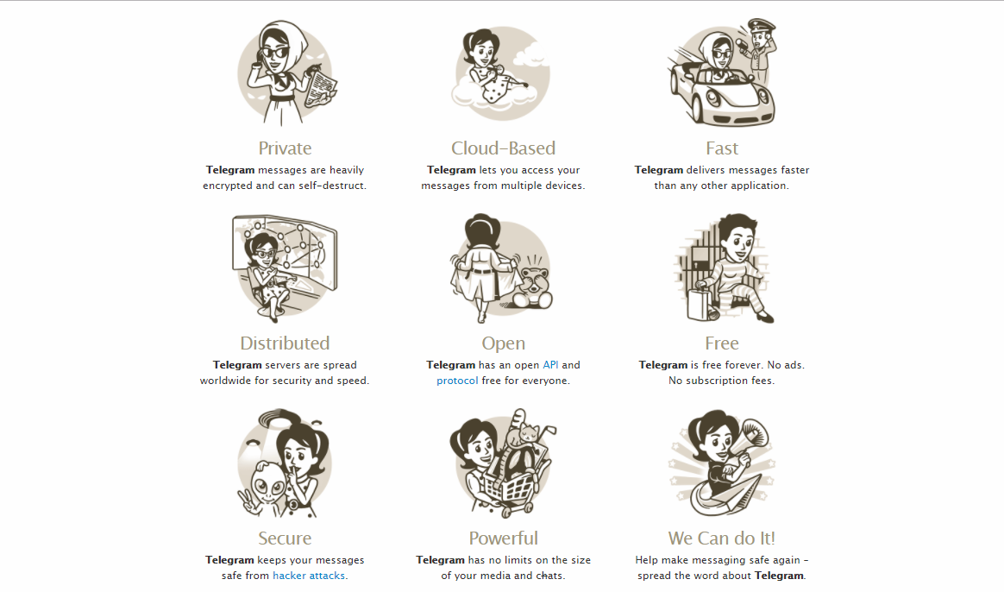

Slide 11
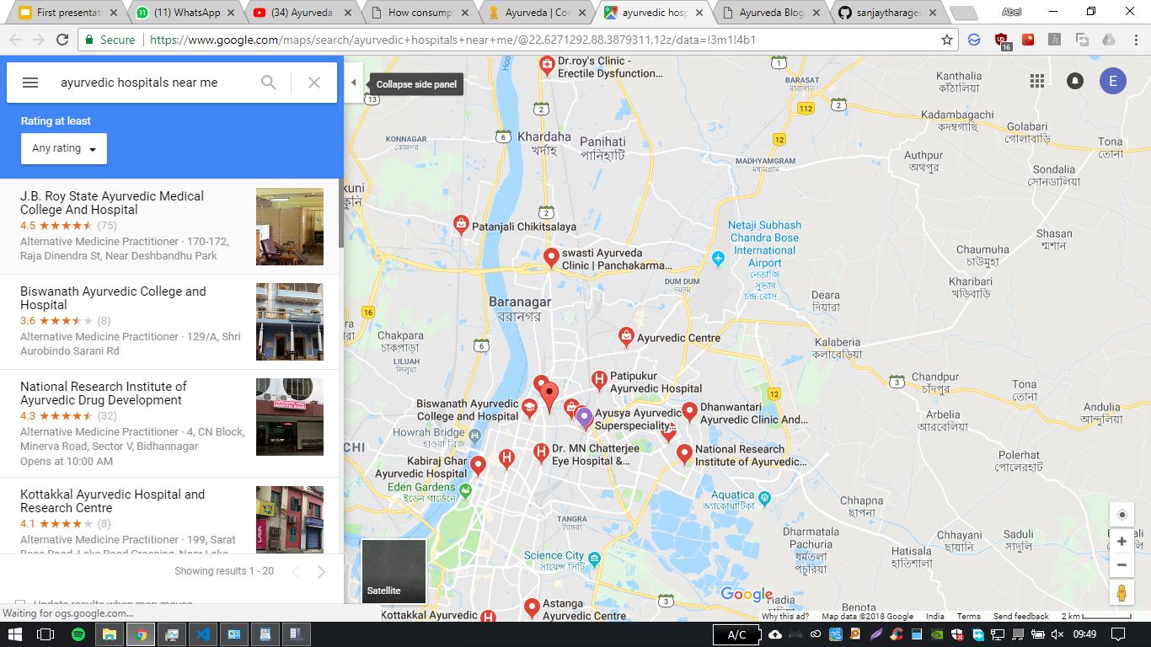
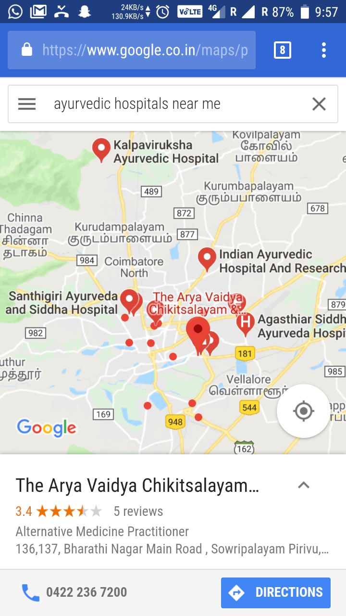
Finds Ayurvedic Organisations:
Finds Hospitals, Organisations and Pharmacies near the user
Provides Contact information, reviews of the organisation, etc

Slide 12
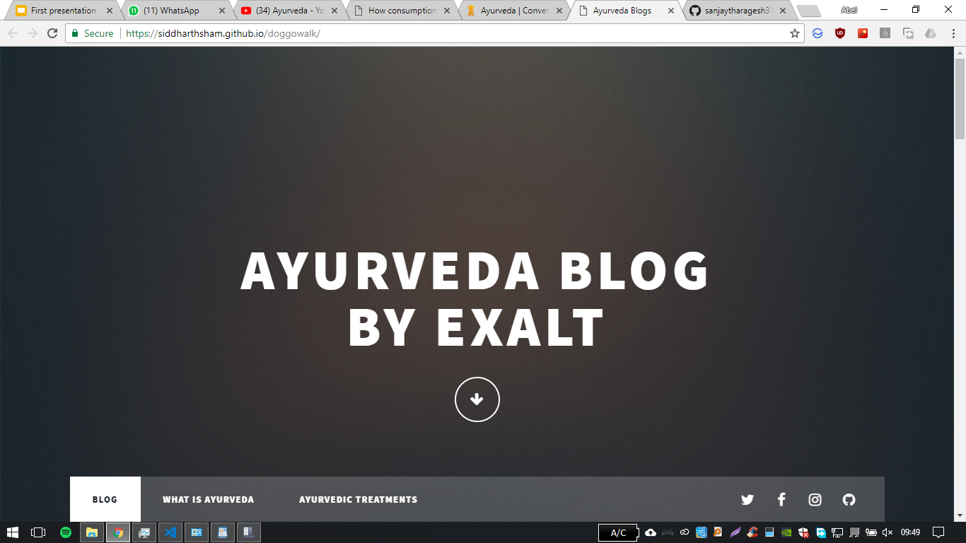
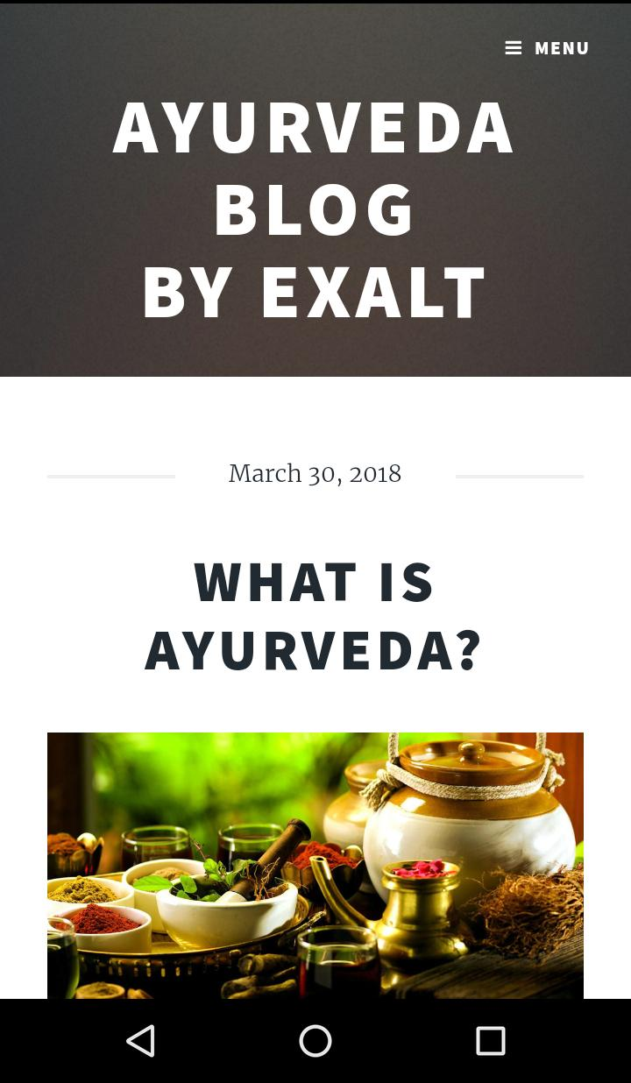
Ayurveda Blog
Allows organisations to provide updates, recent news about Ayurvedic Medicine
An interactive platform which helps the user to understand what is Ayurveda and the history behind it.
Simple, Minimalistic Design

Slide 13
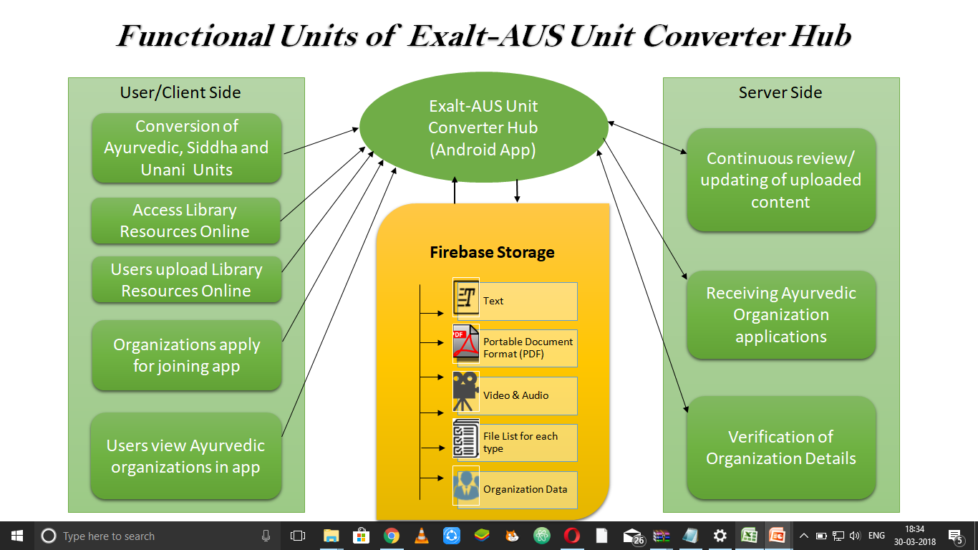

Slide 14
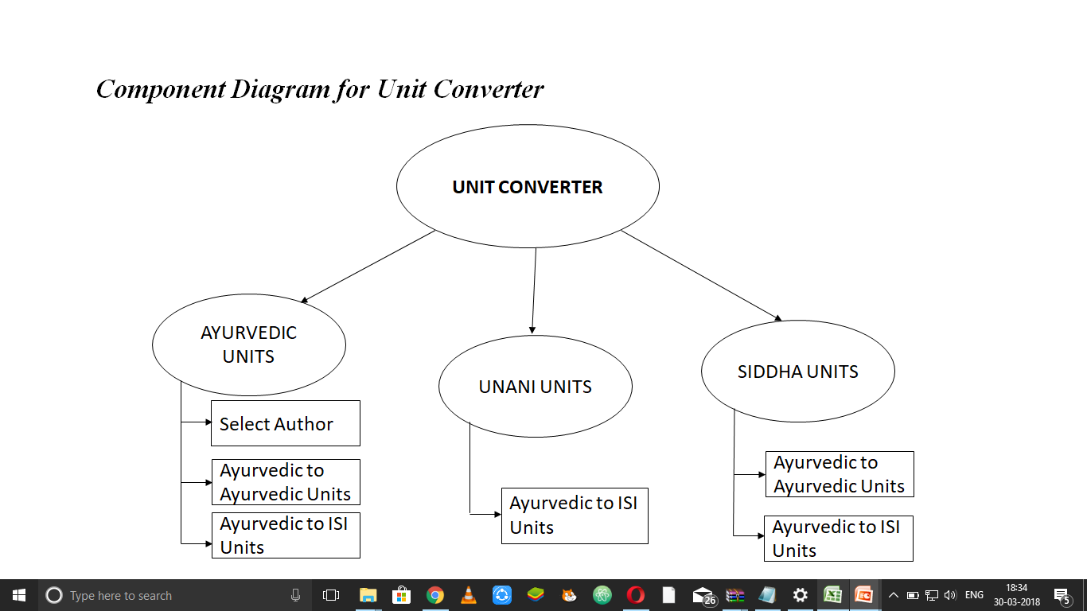

Slide 15
